Slide 1
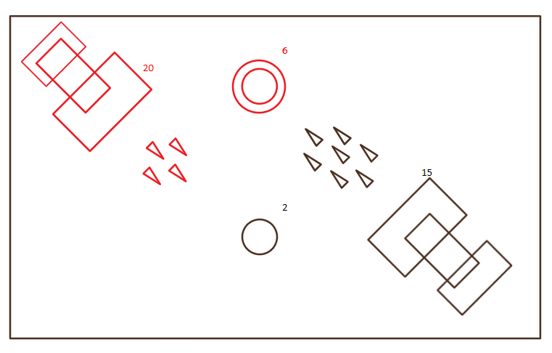
Why Are You Flying A Mothership?
AN outpost and troop management RTS that allows Multitasking without becoming too complicated

Slide 2




Game Overview

Slide 3
Concept
Large Scale: The Solar throne of Eta has fallen, and the remnants of the Queen’s advisers have divided into four factions (plus some independents that serve as minor characters). It’s up to the player character (the Queen’s illegitimate daughter) to try and reclaim the solar system.
Small scale: You control a mothership that has entered an abandoned colony amid the rim worlds in hopes of monopolizing it a forward position. Unfortunately, a rival mothership has also arrived, and you must fight for control of the resources in the colony’s outpost to create a larger fleet, destroy the enemy mothership, and take the colony for your own

Slide 4
Genre
RTS/Action- There are real time strategy elements of troop competition among stationary towers, but there is also a controllable mothership that the player can use to enact special attacks

Slide 5
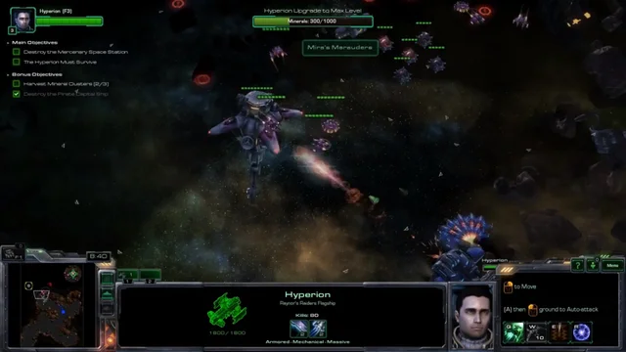
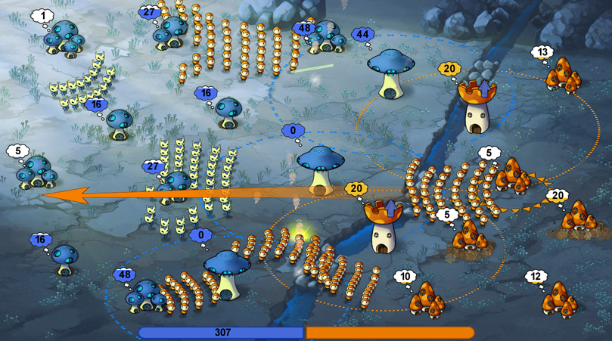
Target Audience
This is aimed at previous RTS game fans such as those of StarCraft and Mushroom Wars (both similar RTS games), but the idea also bears a scary resemblance to a single player League of Legends spin off, so let’s hope they haven’t exhausted this idea yet

Slide 6
Pedagogical objectives
Teach humans how to maneuver both an independent force while still managing the world and environment around them from attack. It breeds a feeling of triumph against constant adversity that may be what is needed to deal with a world where humans tend to hyper focus on one aspect of life

Slide 7
Game Flow
The game will consist of a classic string of levels guided by a preexisting path. The player is trying to expand their influence in the Rim worlds, and they shall be facing other successors to the cosmic throne.
Some levels will be based around being the first to take over an unclaimed colony and destroy the enemy mothership.
Others will be defense missions as the enemy starts with greater numbers, you must survive and then take advantage of your local defenses to push them back
Finally, each sector will have a boss mission where you have to directly attack the enemy’s capital outpost with a strength based on how many bases in the sector you’ve taken over. There will be a base requirement, but some grinding will be optional

Slide 8
Look and feel
The game has a Cold War Era-Science Fiction look, with the focus on the wonders of Atomic power and Faster than Light travel. There are also Feudalistic elements that work their way into the monarchal society
The graphics are high poly 3D.
The game should feel slightly tense, and it should still be able to leverage tension without quick movement. (E.g the mother ship doesn’t move too fast, and neither do the fleets because of the distance, but you should be poised for a surprise attack at all times.

Slide 9
Pedagogical scenario
This game teaches multitasking and resource management on the mechanical side due to the base upgrading and strategic combat components and empathy on the story side as you learn than perhaps your enemies aren’t that bad.

Slide 10

Gameplay and Mechanics

Slide 11
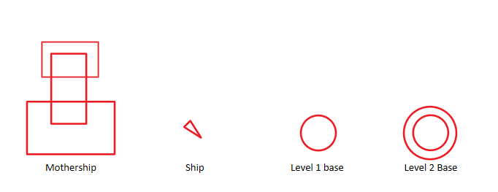
gamePlay
Elements
Mothership
Outposts

Slide 12
Mothership
The player controls a central mothership that they can fly around the field. if it dies, you’re out of the game. The special abilities of the mothership can only be used in its vicinity however, so it’s placement (or misplacement) can mean everything in a skirmish
For example, there’s a tense battle going on next to one of your outposts, and the mothership comes in to offer firepower support and use the unique ability of placing a mobile support drone to shoot approaching ships. This means that the enemy can launch an opposite attack to a weaker outpost the mothership was guarding previously.

Slide 13
Outposts (main functions)
The mothership is moving among various outposts which can be claimed by sending fighter ships to take them over. This outposts can do the following:
Serve as a place to produce troops that can be sent to friendly or enemy outposts. You have a set capacity for ships that is based on the number and size of outposts you control
Sacrifice a set amount of ships for parts in order to upgrade itself to be able to produce more ships. (Each time a base is taken over and flipped from one color to another it will lose an upgrade level)

Slide 14
Outposts (Specializations)
The outposts can be upgraded to with one of the following upgrades (Different factions will have different specialties and you can use it against them if you complete missions in their sector)
Supply depot- allows for the creation of a greater total number of ship
Pulse -creates a set range laser tower on top of the outpost that can attack enemy ships approaching the outpost
Recon outpost- allows you to see the amount of ships (normally hidden from view) in outposts within a specific range
Shield beacon- gives it and nearby outposts a chance to take out an attacking spaceships without sacrificing one for defense.

Slide 15
mechanics
Moving the mothership and its abilities
Generating Spaceships
Sending Spaceships from one place to another
Attacking bases
Upgrading bases
Win conditions

Slide 16
the mothership
The mothership’s movement is controlled with the WASD keys moved around a 2D plane of movement
The mothership’s special abilities are selected with the number keys and if they require a place on the field (such as a minefield) the position is clicked with the cursor. There are a total of two bonus mothership abilities that are selected at the beginning of every mission. The number of abilities available in level and the amount of options for abilities increase through the game, and the amount of accessible abilities in level increase with amount of troops in the possession of the player
If the mothership is destroyed it comes back on a cooldown.

Slide 17
Generating Spaceships
Spaceships are generated naturally up to an outpost’s capacity
The mothership can generate a very small number of spaceships, and they must be targeted at a base. These are usually only used to swing battles, not as a legitimate troop generation plan

Slide 18
Sending spaceships From One Base to another:
Spaceships can be sent from on friendly base to another or to attack an enemy base. This is done by left clicking on the base you want to sent troops from (or shift left clicking for multiple bases) and then right clicking on the destination after choosing one of the following options:
Spaceships stationed at a base can be selected and sent out:
As 25, 50, 75, 100% of the bases’ total forces
As a full force
To even out the number between two friendly bases

Slide 19
Attacking bases
When attacking an enemy base, a number of spaceships are selected from friendly bases to fly towards the enemy base. Base takeover is a pure numbers game similar to Risk, if you have more people than them you can take their base. However, mothership abilities, defensive base upgrades and enemy reinforcements make taking over a base a constant and focused effort.

Slide 20
Upgrading bases
Bases can sacrifice several spaceships contained within them for spare parts in order to upgrade the base’s production capacity.
Tier 0 (Lowest level): can produce up to 20 spaceships
Tier 1 (18 ships): can produce up to 35 ships
Tier 2 (34 ships): can produce up to 50 ships
Tier 3 (60 ships): can produce 55 ships, plus custom upgrade
The total amount of ships that your bases can create is your total capacity. Once capacity is met, none of your bases will produce ships

Slide 21
Win Conditions
In order to win the game, one team needs to take all of the opposing team’s bases and then kill their mothership. As can be assumed, the latter is quite easy to achieve if it is an overwhelming victory, but coming back from just your mothership shouldn’t be ruled out as a possibility.

Slide 22
Game Options
The story mode begins with one faction and their set abilities, but through the campaign they unlock new abilities based on the themes and backgrounds of missions as they defeat their enemies. For example:
Different types of unique upgrades for their towers, for example the shield beacon sacrifices its defensive bonus and instead gains a temporal distortion effect that slows down enemy ships in it’s radius
Different abilities for the mothership, for example a warp jump that allows you to quickly move the mothership across the field. However, the destination must be outside of a certain radius around the mothership
These are all customized at the beginning of a mission, Mission not go well? Try again with different abilities!

Slide 23
Constraints due to the pedological objective
This game cannot be allowed to become too complicated. This means that difficulty cannot be simulated by adding a larger field as that would just burn the player out from over management, however, new characters, new abilities, and new base upgrades should add enough challenge, progression, and content to keep the player going.

Slide 24

Story, Setting, and characters

Slide 25
Story and Narrative
Queen Sarea Harre, seat of the Solar Throne of Eda, has been killed under mysterious circumstances… along with every clear heir to the throne. With ideas of fame, glory, and fortune, her various advisers are fighting among each other in a succession crisis. Unfortunately for them the death of Sarea and her heirs activated P.I.E.H.R.S, an artificial intelligence designed to find the next successor in the event of a crisis. P.I.E.H.R.S steals the decommissioned mothership vessel Cydonia and sets out with a lead for an illegitimate child. Ammyn Cotte initially denies the offer despite the messages sent to her, but after her village is forcibly taken over by the forces of the previous head general she fights back, only to have her parents killed. Eaten up with a desire for vengeance, Ammyn accepts P.I.E.H.R.S’s offer and sets out to get revenge, and maybe sweep up the throne along the way.

Slide 26
Game World
The world consists of four major planets and their moons, the player having to fight through various battles around the planets’ asteroid fields before moving to the next inner ring. The world is a combination of Cold War science fiction and feudalistic society

Slide 27
Characters
Sarea Harre- The previous queen on the solar throne of Eda, after her and her heirs were killed in suspicious circumstances the solar system erupts into combat.
Ammyn Cotte- protagonist, closest blood relation to the solar throne.
P.I.E.H.R.S (Produced Intelligence ensuring heir received smoothly)- The AI that helps to control the ships and the bases of Cotte’s fight. His core is kept personally upon the Cydonia, and he will follow his directive to keep the closest heir moving towards the throne
Jase Reshal- The Queen’s general before her suspicious death, sent the troops to take over Ammyn Cotte’s home that ended up killing her parents.

Slide 28

levels

Slide 29
Types of levels
Race to Claim
Defense
Offence
Survive

Slide 30
Race to claim (RTC)
In race to claim the two main characters each start with a small amount of bases on the edge of a map, and sparsely populated independent bases in the middle. The goal is to take over as many of the grey bases as possible at the beginning in order to have the best chance of clearing the enemy from the map. It’s easy to make mistakes and overextend in the grab for land at the beginning, but greater risk means greater reward when it comes to capturing already upgraded buildings.

Slide 31
Defense
Defense mode starts with possession of the majority of bases on the main field, with the enemy only having a few. However, reinforcements will be warping in on his side of the field, so the best plan is to dig in and hold as much as you can until his reinforcements run out. At that point it could be a piece of cake, or near impossible to knock him out of the map.

Slide 32
Offence
This is where you are viciously outnumbered and just irking onto a map, but you have reinforcements coming to help you take over bases. These reinforcements can be set or can come from completing other story missions in the campaign (maybe you’ll get a fleet of mining drones as reinforcements if you help some asteroid miners protect themselves from pirates)

Slide 33
Survive
There are reinforcements pouring onto the field from increasingly difficult directions, they’re only getting stronger, and your only hope is to keep yourself alive until you can warp out or until reinforcements arrive

Slide 34
Special
These normally have special objectives that allow for a win condition, perhaps you only need to control specific buildings, or reach a certain amount of units. Either way, these are normally saved for story missions where you already have available troops and you really just need to go through an area for story purposes.

Slide 35
Tutorial
The tutorial will come in simple parts:
Teach the player how to control the mothership in the space
Teach the player how to produce spaceships from the motherships
Teach the player to take over and move ships in between bases
Teach the player how to upgrade
Teach the player how to use the mothership’s special abilities
New tower upgrades or mothership abilities will have their own small tutorials
Towers will have a quick cinematic to show their effect
Mothership abilities will have their own involved tutorials so the player knows how to use them and exactly what they can do

Slide 36
Assessment: How is the knowledge/ strategy in the game tested?
When going on the offensive it’s a question of risk vs reward. Do you want to move half of your fleet forwards in order to capture one defensive building, leaving your entire flank open to a sweeping attack from the enemy? Probably not, but not every encounter is an overwhelming victory
Defensive is a question of how to best attrite yourself, you don’t want to sacrifice ships in an area that isn’t of particular strategic advantage and leave your backlines open, and you may have to sacrifice a heavily upgraded building in order to make a stronger retreat. The goal is always to live to fight another solar cycle.

Slide 37

Interface

Slide 38
Visual System
The mothership will be controlled from a top down but still somewhat angled view. This allows the player to see the field as well as some of the background
The mothership abilities will be located at the bottom of the on-screen hud and will have area of effect indicators before they are clicked on the screen if necessary.
The upper right-hand corner will have the pause button, which brings up a menu in which the player can change volume and controls.
The upper left-hand corner will have the total time of the level along with the total ship capacity of the player and the level of their mothership

Slide 39
Control system
Movement controls for the mothership- WASD
Selecting bases and abilities- Left click
Setting the destinations for bases and abilities- Right click

Slide 40
Audio, music, sound effects
There will be sound effects for ships being destroyed in combat, but since it’s something that happens quite often it won’t be too obnoxious
There will be occasional voice lines for characters
The music will have a very futuristic sound to it but will be largely dependent on the area. Different factions will have different motifs, and the player character’s motif will be widely played
There will of course be individual sound effects for shooting towers and the mothership abilities.
The game will have separate volume bars for sound effects and game music

Slide 41
Help system
The player is welcome to revisit the tutorials from the start menu or the controls at any time.

